Slide 1
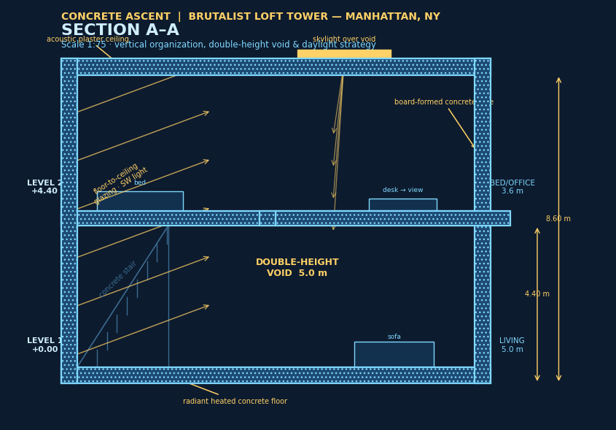
RESIDENTIAL CONCEPT PROPOSAL
CONCRETE ASCENT
A Two-Storey Brutalist Loft in a New York Skyscraper
Board-formed concrete · double-height void · panoramic glazing
Levels 41–42 · Manhattan, New York
CONCRETE ASCENT — Brutalist Loft Tower, Manhattan
01

Slide 2
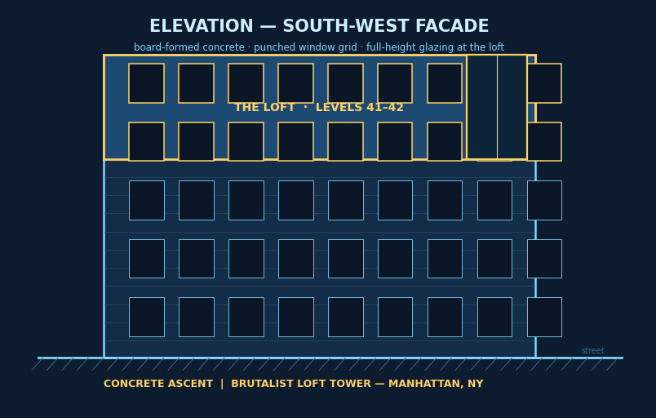
01 — DESIGN PHILOSOPHY
The Concept: Brutalism in the Sky
Honest concrete, monumental volume, and daylight — raw materiality elevated 41 floors above Manhattan.
▸ Brutalist DNA
Cast-in-place, board-formed concrete left exposed on walls, ceilings and the staircase — texture, tie holes and all. Strength expressed, nothing hidden.
▸ Vertical loft typology
A classic New York industrial loft rotated 90°: two stacked levels wrapped around a 5-metre double-height void.
▸ Light as material
Floor-to-ceiling glazing, a roof skylight and an open void flood the concrete with moving daylight, softening its mass.
▸ Sanctuary above the city
Public life below, private life above — the tower's height turns the apartment into a quiet concrete observatory.
CONCRETE ASCENT — Brutalist Loft Tower, Manhattan
02

Slide 3
02 — SPATIAL PROGRAM
Two Floors, Two Moods
104 m² per level · 208 m² total · clear functional split between social and private life
▸ LEVEL 1 — Social & Wellness
Entry foyer · gym · open kitchen with island · dining for six · TV lounge with generous sofas — all wrapped around the double-height void.
▸ LEVEL 2 — Private & Work
Master bedroom · walk-in shower suite · home office with skyline view · library landing overlooking the living space below.
▸ The connective tissue
A sculptural cast-concrete stair; a glazed balustrade keeps the void visually open; service core (risers, HVAC) clad in raw concrete.
LEVEL 1
Entry · Gym · Kitchen · Dining · Living/TV
LEVEL 2
Bedroom · Shower suite · Office
VERTICAL
Concrete stair · double-height void · skylight
CONCRETE ASCENT — Brutalist Loft Tower, Manhattan
03

Slide 4
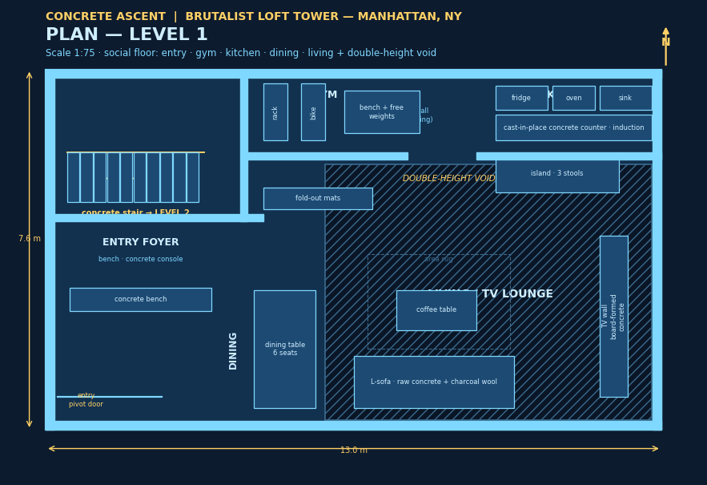
03 — BLUEPRINT
Level 1 · Social & Wellness Floor
Kitchen, gym, dining and TV lounge — everything for daily living and entertaining, on one open plane
▸ Open kitchen
Cast-in-place concrete island, induction hob, full-height pantry wall — cook while facing the skyline and the room.
▸ Gym with mirror wall
Rack, cardio, free weights and fold-out mats; floor-to-ceiling mirrors amplify daylight and views.
▸ TV lounge
Deep L-shaped sofas oriented to a board-formed concrete media wall; rug zone keeps acoustics soft.
▸ Dining for six
Anchored between kitchen and glazing — morning light at breakfast, city glow at dinner.
▸ Entry foyer
Concrete bench and console; pivot door; sightline straight through the void to the skyline.
CONCRETE ASCENT — Brutalist Loft Tower, Manhattan
04

Slide 5
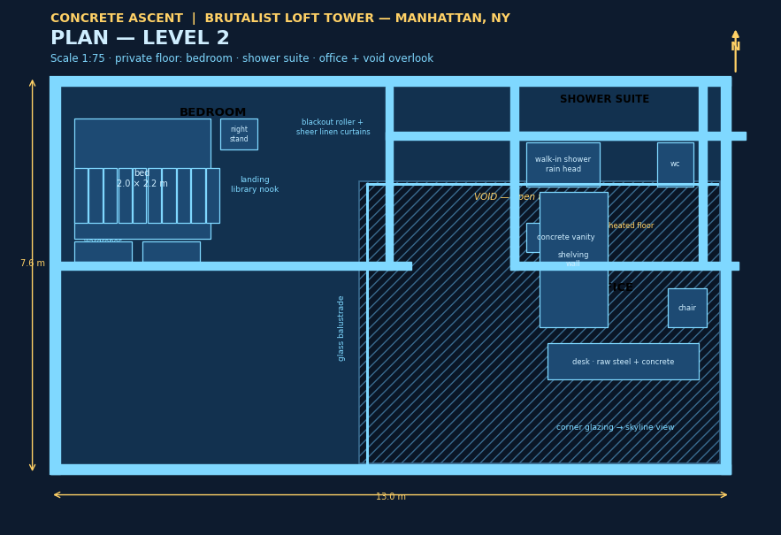
04 — BLUEPRINT
Level 2 · Private & Work Floor
Bedroom, shower suite and office upstairs — rest, wellness and focus above the city's noise
▸ Master bedroom
2.0 × 2.2 m bed, full wardrobe wall; blackout rollers + sheer linen for total light control.
▸ Walk-in shower suite
Rain head, concrete vanity, WC; heated concrete floor and a privacy glass panel.
▸ Home office
Desk positioned at the corner glazing with a direct skyline view — shelving wall behind, void beside.
▸ Library landing
The stair arrival doubles as a reading nook overlooking the living room below.
▸ Glass balustrade
Frameless glazing along the void keeps the floor plate bright and visually connected.
CONCRETE ASCENT — Brutalist Loft Tower, Manhattan
05

Slide 6
05 — BLUEPRINT
Section A–A · How the Loft Stacks
4.40 m level-to-level · 5.0 m void · full-height glazing + roof skylight drive the daylight deep into the plan
▸ Board-formed core
Structure and finish in one: concrete walls, slabs and stair carry the brutalist language through every surface.
▸ Radiant heated floors
Warm concrete underfoot — silent, even heat with no visible radiators to clutter the architecture.
▸ Acoustic plaster ceiling
Softens sound inside the hard shell; concrete mass blocks the city's drone from outside.
▸ Skylight over void
Sunlight drops two storeys into the living space, animating the concrete through the day.
CONCRETE ASCENT — Brutalist Loft Tower, Manhattan
06

Slide 7
06 — LIFESTYLE
The Conveniences of a Two-Storey Loft
Why stacking the program beats a single-level apartment — for living, working and resting
▸ Natural zoning
Kitchen, gym, TV and sofas downstairs; bedroom, shower and office upstairs. No doors needed — the stair does the separating.
▸ True rest upstairs
Bedroom is two floor slabs and a stair-run away from the TV, blender and treadmill — genuinely quiet sleep 41 floors up.
▸ Separation of routines
One person can work late in the office while another watches a movie below — no headphone negotiations.
▸ Guests without exposure
Entertain on level 1; the entire private floor stays untouched and clutter-free.
▸ The void as experience
The double-height space makes 208 m² feel like a townhouse in the sky — drama no flat plan can match.
▸ Better daylight, twice
Two window levels mean morning light reaches the kitchen and evening light reaches the bedroom and desk.
▸ Vertical exercise bonus
The concrete stair adds incidental daily movement between floors — a built-in wellness feature.
▸ Higher value & flexibility
Stacked lofts are rarer and more desirable; the office converts easily to a nursery or guest room.
CONCRETE ASCENT — Brutalist Loft Tower, Manhattan
07

Slide 8
07 — MATERIAL PALETTE
Concrete First, Everything Else Honest
A restrained palette that keeps the architecture in charge
Cast-in-place concrete
Board-formed walls, slabs & stair — the structural finish IS the interior finish.
Glass
Floor-to-ceiling low-iron glazing; frameless balustrade; skylight.
Raw blackened steel
Window frames, office desk structure, kitchen hood and shelving.
Charcoal wool & linen
Sofas, bedding and curtains — texture against the hard shell.
White oak accents
Kitchen stool seats, bedside details — warmth in measured doses.
Polished concrete floor
Radiant heated, sealed — continuous across level 1, timber-look finish upstairs.
CONCRETE ASCENT — Brutalist Loft Tower, Manhattan
08

Slide 9
08 — NATURAL LIGHT STRATEGY
Concrete That Never Feels Dark
Four coordinated moves pull daylight through both storeys from sunrise to sunset
▸ 1 · Full-height glazing
The south-west facade opens level 1 entirely to the skyline; low-iron glass maximises visible light transmission.
▸ 2 · Double-height void
Acts as a light chimney — level 2 borrows daylight from the living room's big windows, keeping the stair and landing bright all day.
▸ 3 · Roof skylight
A 2.6 m skylight over the void drops sun two storeys deep, sweeping across the concrete walls as the day progresses.
▸ 4 · Open balustrade & interior glazing
Frameless glass at the void edge and borrowed light between office and stair means no windowless rooms anywhere in the loft.
CONCRETE ASCENT — Brutalist Loft Tower, Manhattan
09

Slide 10
09 — TECHNICAL SUMMARY
Specification Sheet
Key figures and comfort systems at a glance
Gross internal area
208 m² (2 × 104 m²)
Ceiling heights
3.6 m typical · 5.0 m void
Level-to-level
4.40 m via concrete stair
Facade
Board-formed concrete + full-height glazing
Floor
Polished radiant concrete (L1) · oak-finish (L2)
Heating / cooling
Hydronic radiant floors + concealed VRF
Ventilation
Ceiling-mounted ERV, continuous fresh air
Acoustics
Concrete mass + acoustic plaster ceilings
Smart systems
Lighting scenes, shading, keyless entry
Energy target
NYC Energy Code compliant, high-performance glazing
CONCRETE ASCENT — Brutalist Loft Tower, Manhattan
10

Slide 11
IN SUMMARY
Concrete Ascent proves that brutalism can be warm, bright and deeply livable — a two-storey loft where the city energizes the social floor and disappears entirely on the private one.
Thank you.
CONCRETE ASCENT — Brutalist Loft Tower, Manhattan
11

